Slide 1
Welcome to CS 211

Slide 2
Course Websites
Canvas (now at canvas.Humboldt.edu) is the central hub for the course
Github (https://github.com/acarteas/Teaching-DataStructures/) will be used to store all course materials: course syllabus, official calendar, assignment descriptions, and other course documents

Slide 3
The required textbook is free!
Data Structures and Algorithm Analysis v3.2 by Clifford Shaffer
Find the book on course Github
Also available from the author at https://people.cs.vt.edu/shaffer/Book/C++3elatest.pdf

Slide 4

Other Recommended Reading

Slide 5
I will be periodically asking "clicker" questions in the course (including today!)
Turning point subscription not required

Slide 6
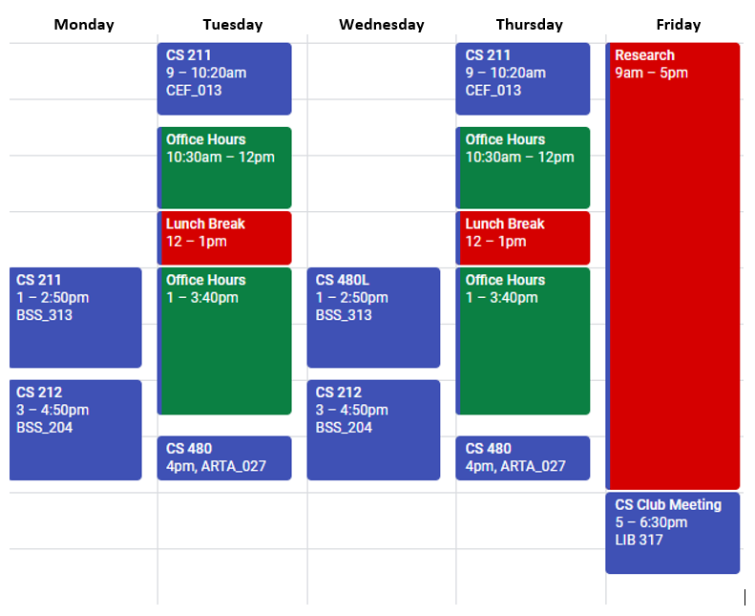
Adam’s Schedule

Slide 7
Grading
I’m continuing my “progressive” grading scheme from last semester
Idea: I care more about what you know at the end of the semester than what you know at the beginning of the semester
Possible solution: Through permissive grading, make it easier to get good grades at the beginning of the semester
Example: In order to get an A on PA1, you only need to get 70 out of 100 points possible.
On the final PA, you will actually need to earn 90+ points to get an A
Notes:
My hope is that this system will also allow me to push you while simultaneously allowing you to fail gracefully.

Slide 8
Programming Environments
I encourage you to use an IDE when working on your solutions. In class, I will be using the Clang C++ compiler. It is much more cross platform than G++. Therefore feel free to use any IDE that supports Clang (All lab computer should have this installed).
My preference for IDEs are:
Visual Studio 2017 with Clang support (requires extra plugin)
JetBrains CLion
Netbeans 8.1
CodeBlocks

Slide 9
Homework Policy
All homework must be submitted by the due date; NO LATE TURN-INS!

Slide 10
A Note on Cheating
Don't do it!
See syllabus for examples of cheating.

Slide 11
Grade breakdown
Participation (3%)
GitHub usage (5%)
Programming assignments, homework, and micro assignments (39%)
Labs (10%)
Two midterm exams (9% / ea)
Final exam (25%)

Slide 12
Final grade translations
93.00 – 100.00 | A | 71.00 – 75.99 | C
90.00 – 92.99 | A- | 69.00 – 70.99 | C-
87.00 – 89.99 | B+
82.00 – 86.99 | B | 60.00 – 68.99 | D
78.00 – 81.99 | B- | 00.00 – 59.99 | F
76.00 – 77.99 | C+

Slide 13
GitHub demo

Slide 14
Today's review topics
Reading from and writing to files
Sending ifstream objects to functions
Reading from and writing to CSV files

